Slide 1
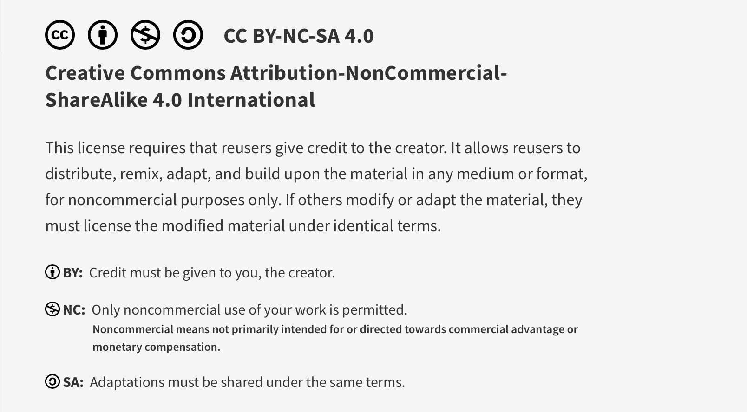
This work is licensed under CC BY-NC-SA 4.0. To view a copy of this license, visit: https://creativecommons.org/licenses/by-nc-sa/4.0/

Slide 2

Human Factors and Human Limitations
Lucie Filteau, MD, FRCPC
PGY 2-4 Academic half day
QPS Series

Slide 3
Ottawa Anesthesia QPS Curriculum
PGY 1
PGY 2-4
Intro to Safety
Handover
Stress and Substance Abuse
IPAC Session
Positioning Workshop
Intro to Quality Improvement 1
Intro to Quality Improvement 2
Systems Thinking and Design
Human Factors
Resource Stewardship
Situational Awareness, Teamwork and Communication

Slide 4
The Safety Competencies
http://www.patientsafetyinstitute.ca/English/toolsResources/safetyCompetencies/Pages/default.aspx

Slide 5

Common Examples of Cognitive Biases in Medicine (NB: can have > 1 at a time!)
Anchoring
Premature closure
Zebra retreat
Search satisfaction
Bandwagon effect
Attribution error
Authority bias
Availability heuristic
https://www.cmpa-acpm.ca/serve/docs/ela/goodpracticesguide/pages/human_factors/Cognitive_biases/pdf/hf_common_cognitive_biases-e.pdf

Slide 6
Think-Pair-Share Exercise
Pair up with a partner
Think about examples of cognitive bias that you have experienced or observed in a clinical setting
What circumstances or strategies might have mitigated these biases?

Slide 7
Discussion of biases and mitigating strategies

Slide 8
Human Factors
“Human” Factors focuses on impact of environmental factors surrounding the human
There are limitations to our abilities – physical and mental
We must accept this!
HF aim: design our work environment to make it easier for us to do the right thing

Slide 9
Examples of Equipment Design Elements
Physical (weight, size)
Psychological (intuitive menus)
Ergonomic (height/tilt adjustment)
Auditory (alarms tone, volume)
Software (default settings)
Safety features (alarm types and limit settings)

Slide 10
Think-Pair-Share Exercise
Pair up again
Think about the equipment that you interact with on a daily basis
Generate 1 example of both great and poor design/usability
For the poor list, try to be specific re the issues

Slide 11
Discussion of well/poorly designed equipment

Slide 12
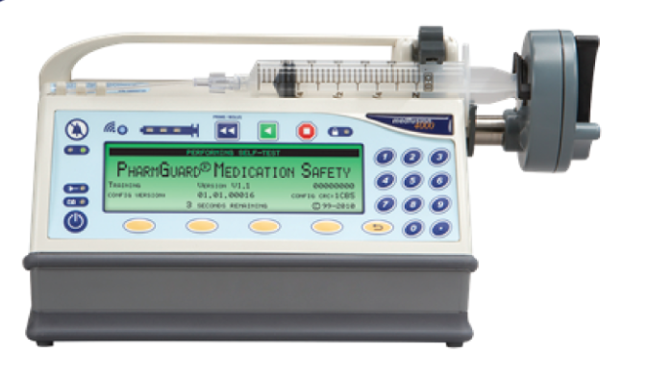
Notes:
REAL WORLD EXAMPLE:
Software upgrade applied to syringe pumps:
Prior to pump upgrade: Options menu: #1 was Bolus
After software upgrade: Option #1 resulted in Standby mode (= opposite function!) = major safety issue!!
Upgrade process was not done overnight (phased) so pumps with opposite settings co-existed…

Slide 13
QPS Work
Individual adverse event submission
HF not readily apparent, submitter feels at fault, ashamed
QPS Committee adverse event analysis
Reveals Human Factors at play
Clusters of similar reports confirm that well meaning healthcare providers “set up to fail"

Slide 14
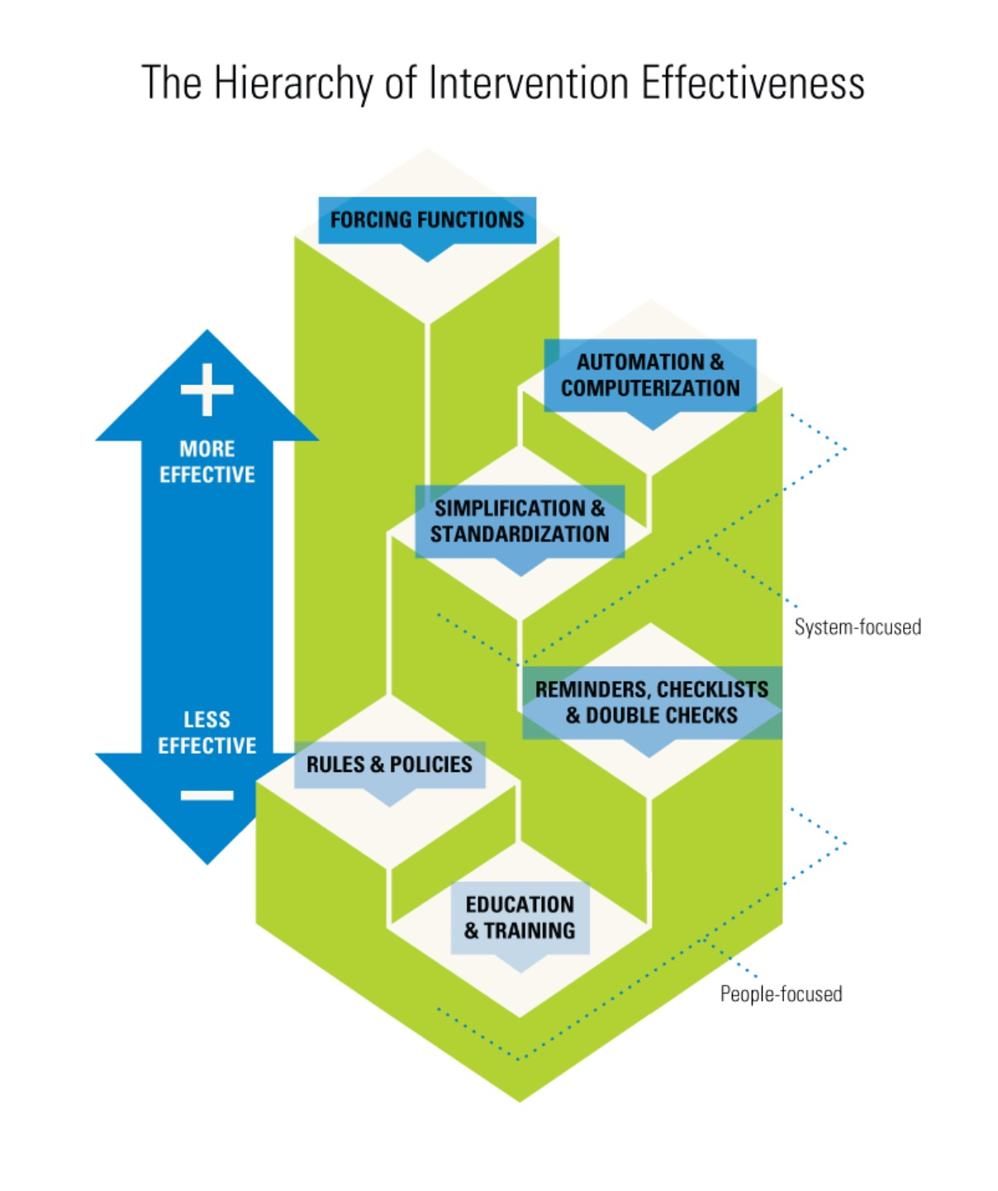
Hierarchy of Intervention Effectiveness
Forcing functions
- O2/N2O/Air hoses
Automation
- EPIC allergy warnings
Standardization
- Care maps
Checklists
- Surgical safety checklist
Policies
- Hospital PPE usage rules
Education/training
Diagram created by Cassie McDaniel
Notes:
In distant past: could switch connections of O2, N2O and air hoses!

Slide 15

1978
Dr. Jeffrey Cooper (PhD)
Bioengineering Unit, Department of Anesthesia and Critical Care at Massachusetts General Hospital
Lead team that used aviation-inspired incident analysis technique to understand causes of mishaps/injuries
Is widely regarded as the “father of patient safety research.”
Slide adapted from TOH Grand Rounds presentation by Dr. Joshua Roberts, May 2018

Slide 16
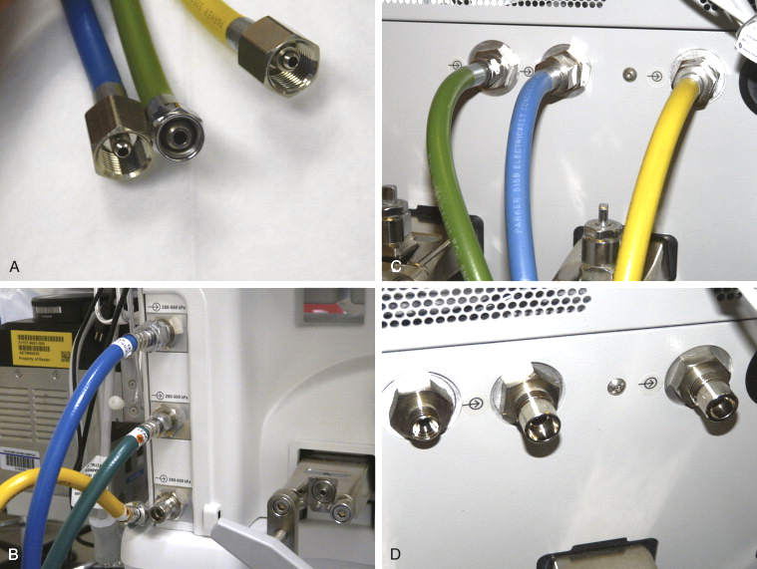
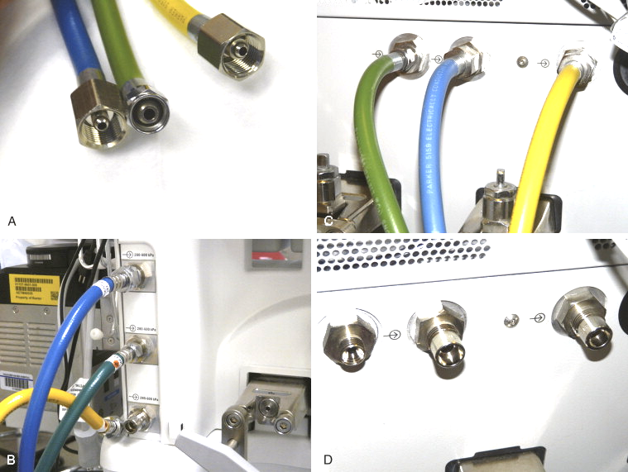
Slide adapted from TOH Grand Rounds presentation by Dr. Joshua Roberts, May 2018

Slide 17
Today’s Forced Functions: Work in Progress
The International Standards Organization (ISO) created ISO 80369 in 2016: to ensure that small bore connectors used for one route of administration (e.g. IV, enteral, neuraxial) cannot fit for another route
ISO 803696-6: Standardization of neuraxial connections that are not compatible with Luer lock system
Notes:
Time to design the new standard
Movement away from commonly used Luer lock: NG tubes, NIBP cuffs
COVID: delayed development work, production
Neuraxial specific connections now available
No Canadian hospital has made transition yet
Need admin buy in, $
Big change project involving many depts
Needs ++ coordination
Concerns remain re supply chain stability

Slide 18
Slide from TOH Grand Rounds presentation by Dr. Joshua Roberts, May 2018

Slide 19
Slide from TOH Grand Rounds presentation by Dr. Joshua Roberts, May 2018
Notes:
The child died

Slide 20
Slide from TOH Grand Rounds presentation by Dr. Joshua Roberts, May 2018
Notes:
The patient died from a fatal air embolus, despite resuscitation efforts

Slide 21
Slide from TOH Grand Rounds presentation by Dr. Joshua Roberts, May 2018
Notes:
The epidural medicine was delivered to the IV
The patient died

Slide 22
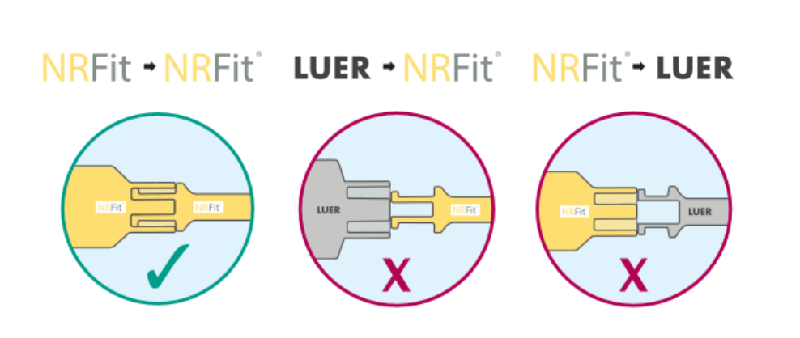
NRFit

Slide 23
“One can consider the epidural space as a human dustbin as virtually every drug or solution used in the hospital has been reported to have been injected epidurally.” (Beckers, Inadvertent epidural injection of drugs for intravenous use. A review. Acta Anaesthesiol Belg, 2012)
succinylcholine | methohexital | cefazolin | chlorhexidine
rocuronium | diazepam | MgSO4 | amox/clav
cisatracurium | midazolam | glucose | gentamicin
atracurium | ephedrine | TPN
vecuronium | metaraminol | labetalol
pancuronium | ondansetron | ether
thiopental | KCl | paraldehyde
Slide from TOH Grand Rounds presentation by Dr. Joshua Roberts, May 2018
Notes:
Since this quote: can add tranexamic acid

Slide 24
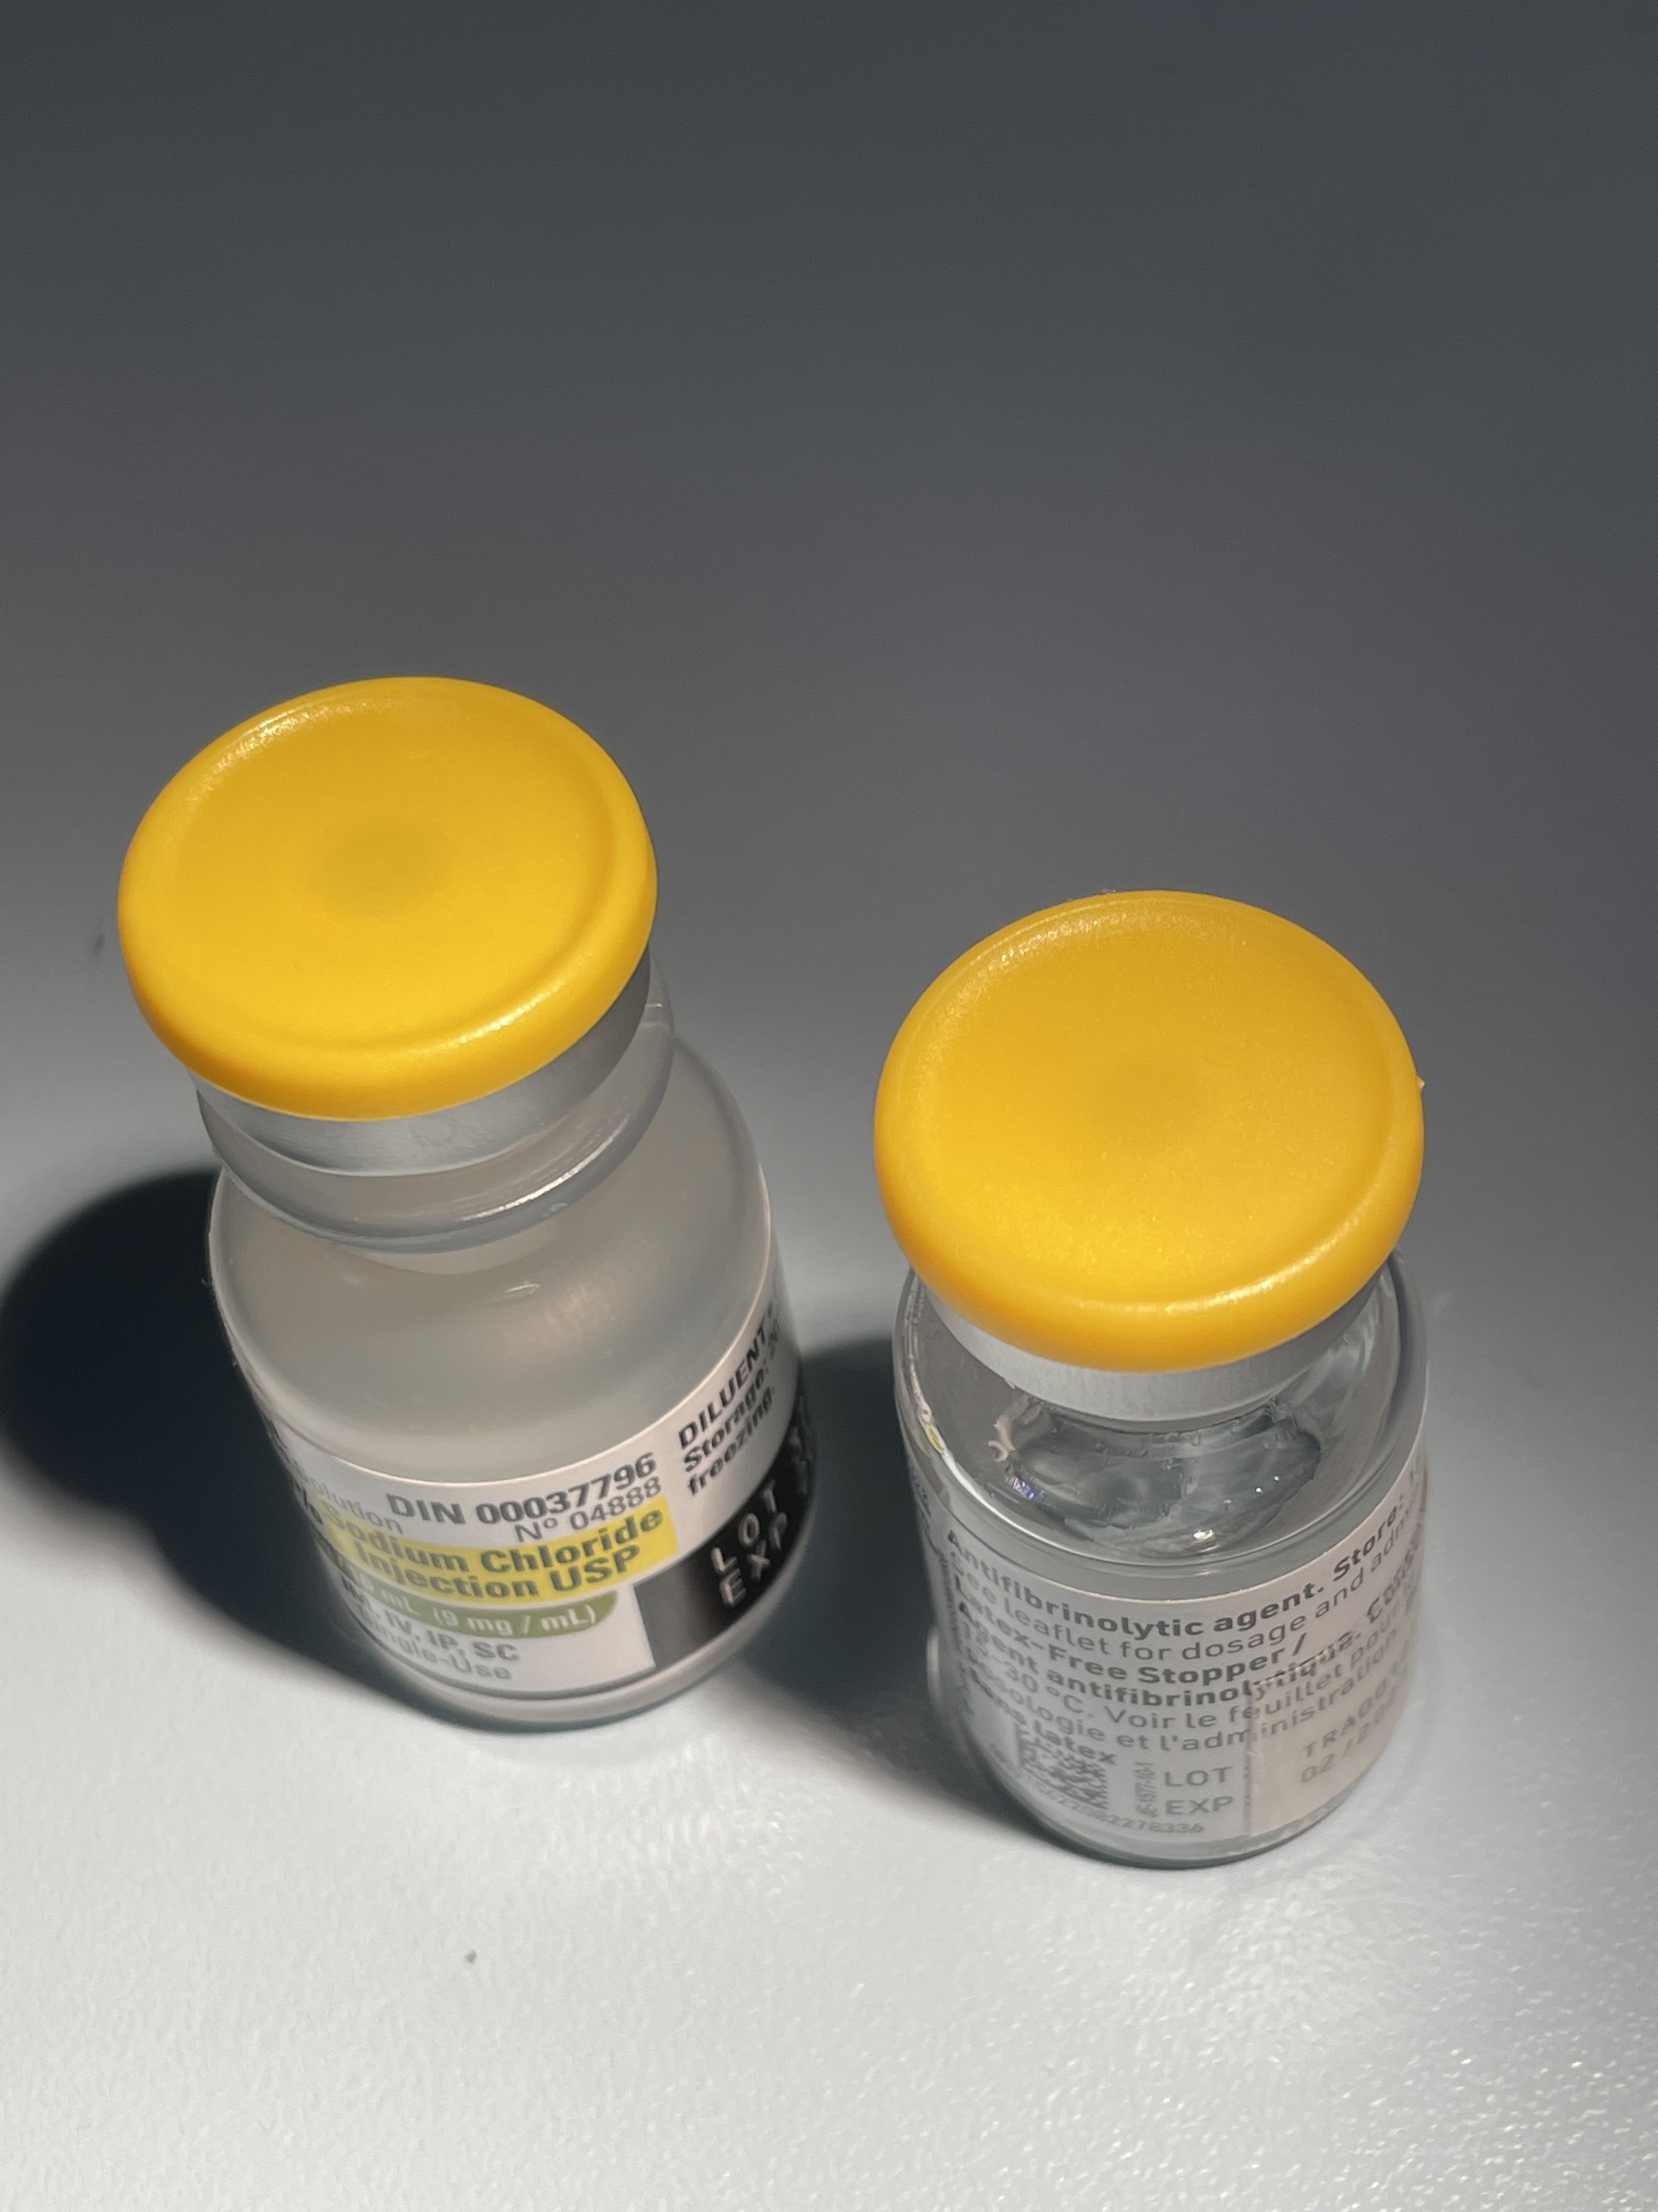
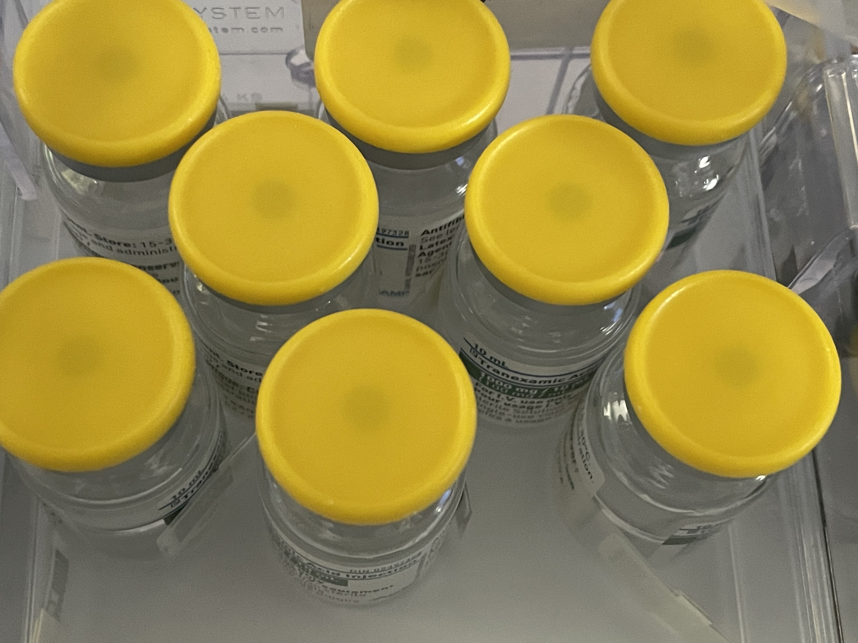
New Threat on the Block
Tranexamic Acid

Slide 25
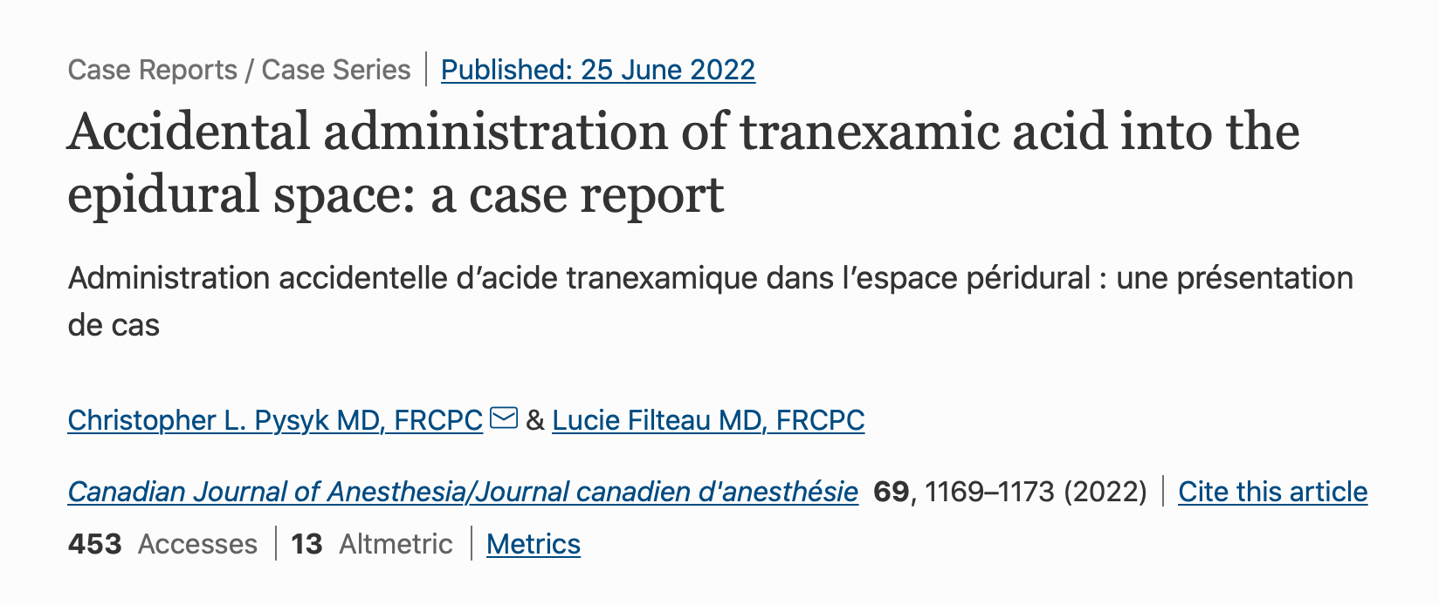

Slide 26

NRFit
Institute for Safe medication Practices (ISMP) article:

Slide 27
How YOU Can Contribute to Improved HF
Participate in industry focus groups in design phase
Participate in dept’s new equipment education/evaluation
Have an HF lens and offer feedback when changes are planned
Send faulty equipment to Biomed
Report errors, near misses to highlight human factors
Join the Canadian and/or International Standards Association (CSA, ISO) to help develop the standards

Slide 28

Vanessa’s Law (Dec 2019)
AKA: Protecting Canadians from Unsafe Drugs Act
Hospitals are obligated to forward certain SLS reports directly to Health Canada
Medical device incidents
Serious adverse medication reactions
Health Canada
Granted enhanced powers to take action when risk to health identified

Slide 29
New Health Canada Powers
Power to require information, tests or studies
Power to require label change/package modification (health warnings)
Power to recall unsafe therapeutic products
Ability to disclose information in certain circumstances
Power to impose tougher measures for noncompliance (fines, jail time)

Slide 30
The End!

Slide 31
This work is licensed under CC BY-NC-SA 4.0. To view a copy of this license, visit: https://creativecommons.org/licenses/by-nc-sa/4.0/

